Slide 1
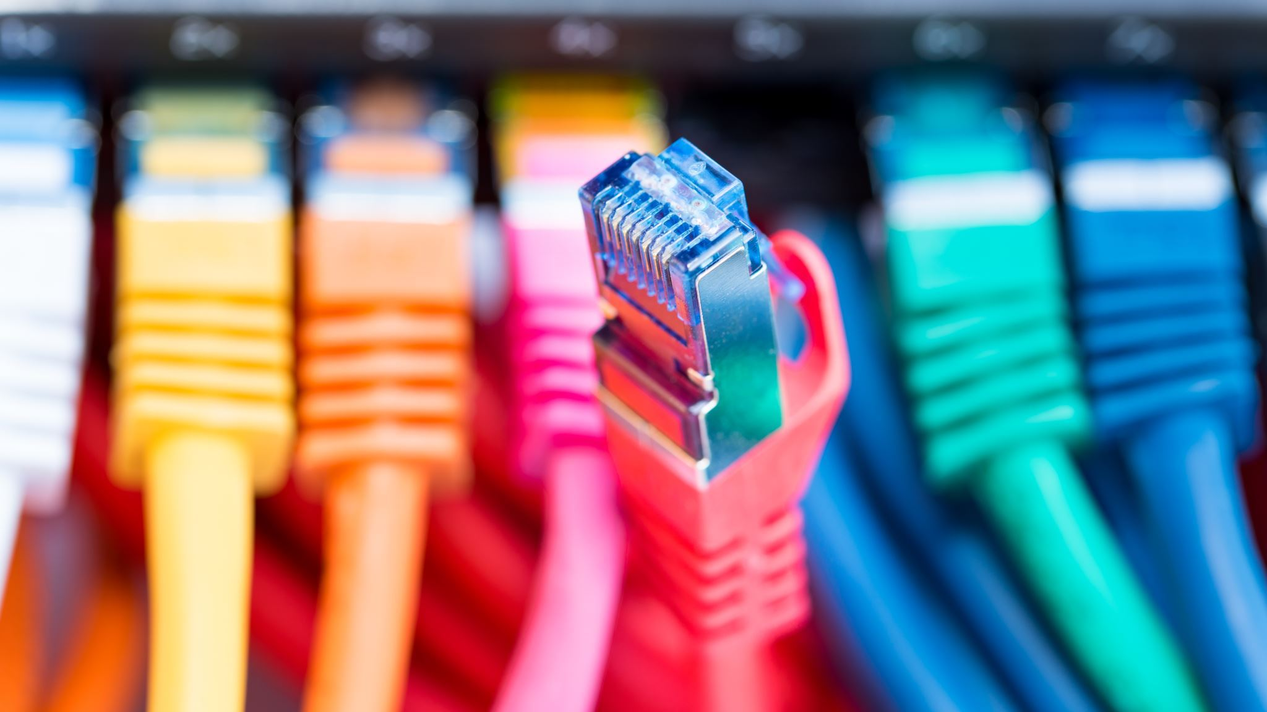
Ethernet
Ethernet is most widely used LAN technology and it is defined under the 802.3 IEEE standard.
It uses Bus topology (Bus topology is where all the devices connected to eact other through the common single wire)
It is used in limited geographical area because of its flexibility and high speed.
Ethernet operates in two OSI layer called Data link layer(MAC), Physical layer.
Ethernet also used with CSMA/CD
It uses Manchester Encoding to transfer the data in bits
In automotive 802.3cg(10BASE-T1S), 802.3bw(100BASE-T1), 802.3bp(1000BASE-T1) etc. Ethernet standards are used.

Slide 2
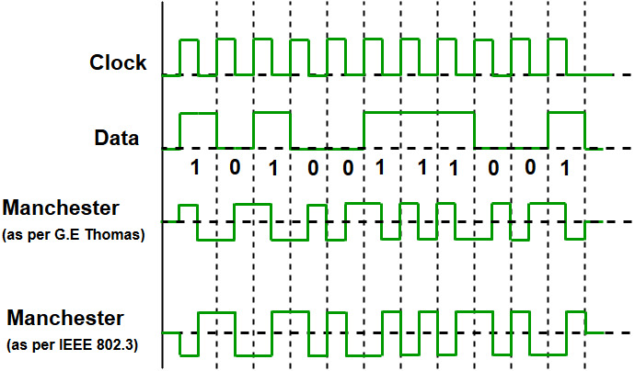
Manchester Encoding:
In Manchester Encoding the duration of bits divided into
Two halves.
The voltage level remain same at first half and change at second half
The Transition provides the synchronization
In this there is always transition between the middle of bit but its value defined at the start
If next bit is zero there will be transition and if next bit is one there will not be any transition

Slide 3
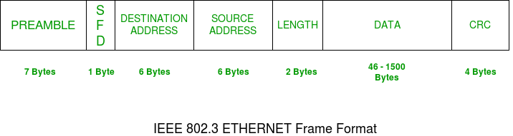
Ethernet Frame Structure
Preamble : total size 7 Bytes , used to indicate the starting of the frame. It contains alternative 0 and 1s. It allows sender and receiver to synchronization.
SFD: start of frame delimited. It indicate that frame is starting. It has 1 byte size and has value is 10101011.
Length : It indicate total length of the etherate frame

Slide 4
CRC : Cyclic redundancy check used by sender and receiver both. They both calculate this value if the both value match message is from authentic source. Total size is 4 Bytes.
DATA : data field used to transfer the actual data is have size upto the 45-1500 Bytes

